Slide 1
Applied Text Analytics
Dr Neamat El Gayar
Program Director of MSc Artificial Intelligence
n.elgayar@hw.ac.uk
F20/F21AA
Notes:
Important question : how to convert the unstructured data (text) into structured form ?
This step will include pre-processing & representation
On the structured form you can apply predictive analytics to derive valuable information such as sentiments, trends, topics of interest ,…

Slide 2
Sources of Text
Text Sources
Health care and Life Sciences
Retail
Travel and Hospitality
Banking and Financial Services
Telecommunications and High Tech
Construction
Emails
Product/ Service Review
Customer Feedback
Live Chats
Calls centre logs
Social media posts (Tweets)
Surveys
Medical records
Legal documents
Scientific Literature
Notes:
We focus on the ‘text’ and ‘analytics’ component and related tools
Text:
Client interactions, product reviews, call center logs, emails, blogs, tweets
Text Sources: Digital Libraries, Electronic news, social media, web, chat logs
Analytics:
Tools to work on data and gain insights ( example visualization, pre-processing and machine learning )

Slide 3
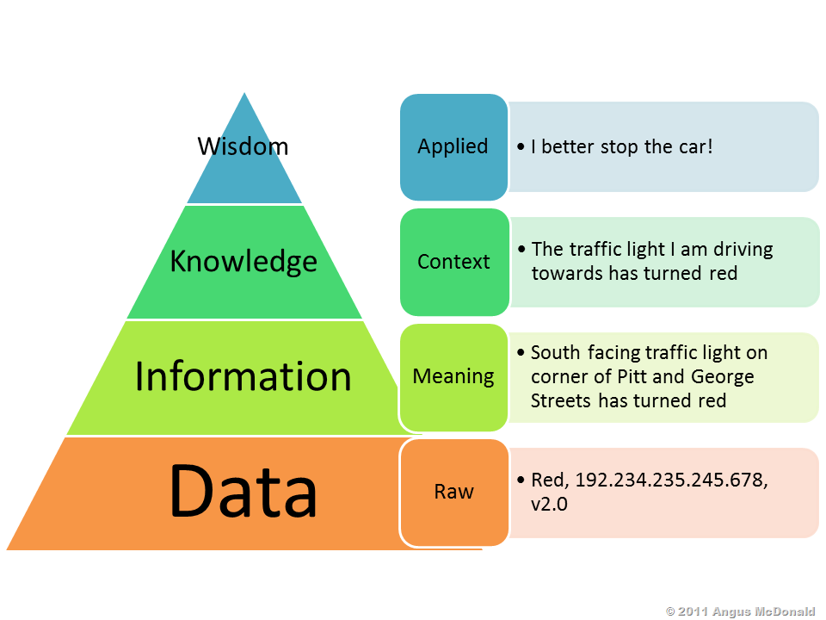
Text Data Growth?
Less than 1% of the data is analysed
Vast portion of this data is text (79%)
Forbes 2018:
90% of all data today created in the last two years Daily data output is more than 2.5 quintillion bytes.
Text Data /every minute:[2017]
456,000 new Tweets
510,000 new comments on Facebook
16 million text messages
156 million emails sent
103,447,520 million Spam emails
2020 and beyond: “1.7 Mb of data will be created every second for every person on the planet.”
Notes:
The vast portion of this data (about 79 percent) is text data.
As a report by EMC says, less than 1% of the world’s data is analyzed and processed. Taking into account that the industry keeps growing, we can assume that the percentage will reduce in the future.
we have learned how to collect and store terabytes of data, but still barely understand how to process it.
Industry experts have predicted that the demand for NLP experts will grow exponentially in the near future.

Slide 4
Value from Text ?
Classify an email message as either legitimate or spam
From content of the email
Learn about the opinion of your customer on your product/service. ( or the competitors)
From individual’s comments or tweets.
Find out if a message is a complaint or an inquiry.
From subject line and content of a message
Notes:
Customer service determine complaint: automatically determine the customer’s intent, which allows us to send the message to the appropriate department, or even send a fully automatic reply.
analyzing text written by customers in a customer survey, with the focus on finding common themes and trends. The idea is to be able to examine the customer feedback to inform the business on taking strategic action, in order to improve customer experience.
analyze data collected from your website or social media channels in the best way.A text mining system allows filtering out spam and detecting fraud.
is social media monitoring, where an analysis is performed on a pool of user-generated content to understand mood, emotions and awareness related to a topic.

Slide 5
Text Analytics
“Text”
“Analytics”
Client interactions, product reviews, call center logs, emails, blogs, tweets
Text Sources: Digital Libraries, Electronic news, social media, web, chat logs
Tools to work on data
Gain insights using:
Visualization
Transformations
Machine learning
Tell the story behind the data!
Notes:
Analysing unstructured text to obtain insights and translate into actions for improvement
We focus on the ‘text’ and ‘analytics’ component and related tools
Text:
Client interactions, product reviews, call center logs, emails, blogs, tweets
Text Sources: Digital Libraries, Electronic news, social media, web, chat logs
Analytics:
Tools to work on data and gain insights ( example visualization, pre-processing and machine learning ) – drive business value
find patterns and topics of interest, and then take practical action based on what you learn. Analytical tools that in combination with data visualization tools, this technique enables companies to understand “tell “ the story behind data

Slide 6
Some topics covered in the course!
“Text”
“Analytics”
Text Processing
Keeping the relevant data
Reducing dimensionality
Text Representation
Bag of word
Vector Space Model
N-gram features- context
Text as a sequence of words ( hot-one encoding -Word2vec)
Text Classification
Topic modelling
Deep Learning for NLP applications (Sequence to Sequence model)-Transformers
Notes:
What makes text different from other form of data?
Unstructured data ( need for preprocessing)
We focus on (20%) of the most common tool , that are useful (80%) of the time.
We discuss important techniques in this field:
Important question : how to convert the unstructured data (text) into structured form ? This step will include pre-processing & representation
On the structured form you can apply predictive analytics to derive valuable information such as sentiments, trends, topics of interest ,…translating large volumes of unstructured text into quantitative data to uncover insights, trends, and patterns.

Slide 7



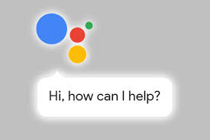

Related Fields
Machine Learning: Models that learn from data
Information Retrieval: indexing, ranking and search of electronic documents & database management issues.
Natural Language processing: understanding human language. Deals with linguistics and language parsing. Can also include speech
Notes:
Text analytics, applies methods from several fields, such as Computational Linguistics, Information Retrieval, and Statistics, and has a variety of applications that are relevant to both business intelligence and scientific research.
IR is about document retrieval, emphasizing document as the basic unit. (web search - involves serving already known information to a user. ) -Finding documents relevant to user queries
Technically, IR studies the acquisition, organization, storage, retrieval, and distribution of information.
search results only point to the location of documents, leaving searchers with the problem of having to spend hours manually extracting the necessary data by reading through individual documents.
NLP, related to AI where the idea emerged that we should be able to communicate and interact with electronic devices and digital information as naturally as we would interact with another human being

Slide 8
History of NLP approaches
Computational Linguistics
Data-Driven approach to NLP:
Train models to encode the grammatical structure of a language from text examples.
Models can be used with arbitrary languages and applications
Text analytics:
draws on some NLP tools
Generative AI and prompt Engineering (now those feedback into understanding the language-humanities )
Phonological Analysis
Related to speech ( how words are uttered)
Morphological Analysis
Form of words
Syntactic Analysis
Meaning
Semantic Analysis
Grammar
Notes:
NLP focuses more on language specifics ( parsing/grammar/semantics) It extracts the semantic meanings and analyzes the grammatical structures the user inputs.
- you can build a robot that can understand people and interact with them in any language.
NLP come of age over the past ten years, with products such as Siri, Alexa and Google's voice search employing NLP to understand and respond to user requests.
Personal assistants, translation software self-service phone banking applications , chatbots
Text analytics use ML and data-driven techniques , ignoring rules of the language [ don’t look into it]. does not consider semantic features ( not necessary understanding the meaning , but focus on driving the insights) - features based on analysing word frequencies.
Skills : Python, NLTK – Spacy]

Slide 9
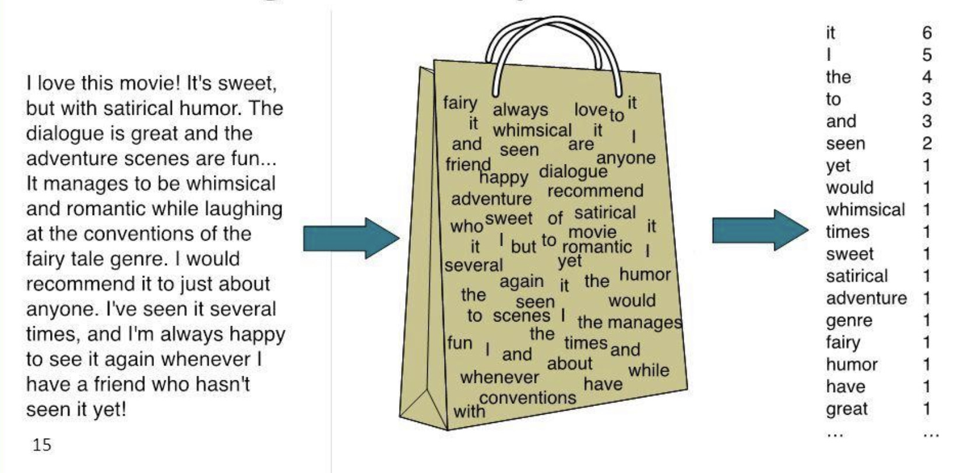
Early model to represent text: Bag of words
Notes:
Need preprocessing to reduce feature space

Slide 10
Bag of words representation
I love this movie! It's sweet, but with satirical humor. The dialogue is great and the adventure scenes are fun… It manages to be whimsical and romantic while laughing at the conventions of the fairy tale genre. I would recommend it to just about anyone. I've seen it several times, and I'm always happy to see it again whenever I have a friend who hasn't seen it yet.

Slide 11


The bag of words representation: using a subset of words
x love xxxxxxxxxxxxxxxx sweet xxxxxxx satirical xxxxxxxxxx xxxxxxxxxxx great xxxxxxx xxxxxxxxxxxxxxxxxxx fun xxxx xxxxxxxxxxxxx whimsical xxxx romantic xxxx laughing xxxxxxxxxxxxxxxxxxxxxxxxxxxxxxxxxxxxxxxxxxxx recommend xxxxx xxxxxxxxxxxxxxxxxxxxxxxxxxxxxxxx several xxxxxxxxxxxxxxxxx xxxxx happy xxxxxxxxx again xxxxxxxxxxxxxxxxxxxxxxxxxxxxxxxxxxxxxxxxxxxxxxx
great | 2
love | 2
recommend | 1
laugh | 1
happy | 1
... | ...

Slide 12
Processing Raw text
How to convert unstructured data into a structured form
Platform-centric extraction and parsing:
Extracting individual tokens
Token= sequence of characters as a unit of processing
Analyst has to make judgement which meta-data can be removed ( HTML /XML documents)
Preprocessing of tokens: ( converting tokens to terms)
Vector Space representation

Slide 13
Processing Raw text
How to convert unstructured data into a structured form
Platform-centric extraction and parsing
Preprocessing of tokens: ( converting tokens to terms, discarding )
Remove stop words: prepositions, conjunctions, pronouns, and articles are considered stop words. [ a, an, the ,and..]
Stemming: consolidate words with the same root [eat, ate, eating,…]
Case folding, punctuation, Special characters, Emoji
Vector Space Representation
Notes:
We will study those processes in the course

Slide 14

Tokenization
Deciding on word boundaries is language specific
English: New York ( one token or two?) . State-of-the art?
French: l’ensemble , un unsemble
Chinese and Japanese no spaces between words
German compound nouns:
Rechtsschutzversicherungsgesellschaften
“legal protection insurance companies”
In Arabic a single word can comprise up to four independent tokens:

Slide 15
Stemming vs. Lemmatization
In stemming each word is replaced by its word stem
Uses a rule-based heuristic (crude chopping of affix)
Most popular algorithm: Porter Stemmer (Snowball)
Example :
are → ar
equivalent → equival
ponies → poni
user, used, users , using-> use
Lemmatization uses a dictionary of known word forms “lemma””
Uses POS tag ( language specific) –[verb-noun –article]
Example :
am, are, is → be
car, cars, car's, cars' → car
Filling (verb) → fill
Filling(noun) → filling
Reduces dimensionality & feature size (can help with overfitting in ML models)
Notes:
Lemmatization is a more sophisticated approach because it uses the specific part of speech in order to determine the root form of a word. The normalization rules depend on the part of speech and therefore, they are highly language specific

Slide 16
Vector space model
Each document is represented as a vector. All documents are projected into the space.
One dimension for every unique term in space(axes)
Cosine similarity
Jaccard Similarity
Finance
D₂
|D₂-D₄|
High-dimensional vector space: 10,000+ dimensions, or even 100,000+
D₄
D₃
Sports
Education
D₅
D₁
Notes:
For text, cosine similarity of tf.idf weighted vectors is typically most effective.
Similar results are obtained with the Jaccard and cosine coefficients
The Jaccard coefficient is especially useful for the case where the Boolean representation of text is used.

Slide 17
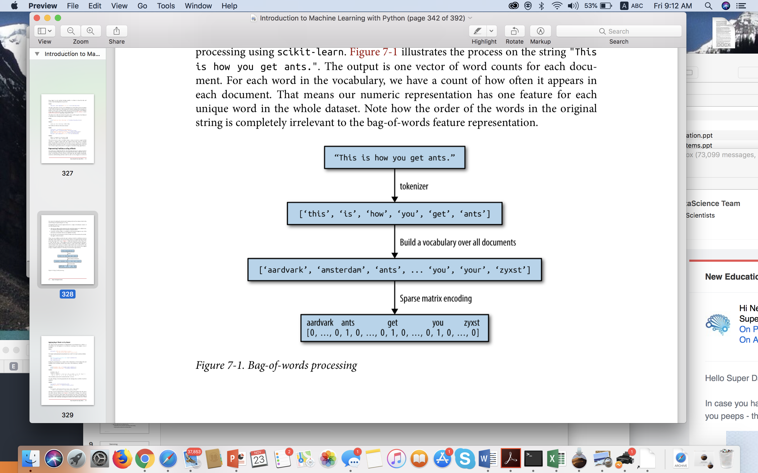
Bag of words example
Most simple but effective and commonly used ways to represent text for machine learning
For applications such as classification, topic-modeling, and recommender systems, this type of representation is sufficient.
Notes:
Words are treated as dimensions with values corresponding to word frequencies
Machine learning models often use the bag-of-words representation
For many applications such as classification, topic-modeling, and recommender systems, this type of representation is sufficient.

Slide 18
Document Vectorization
Document is represented with a numerical vector
Dimension of the vector =distinct terms in ”corpus”
Method | Function | Description | Comments
Binary “One-hot” | 0 1 | 1 if term occurs 0 otherwise | Can be suitable for shorter documents and NN implementations
Frequency | TF | Counts frequency of terms | Works well for k-means clustering and some probabilistic methods
Term Frequency Inverse Document Frequency | TF-IDF | Weights term by importance across corpus | Originally the gold- standard of Information retrieval
Can use N-gram features
Can be used in combination with PCA for dimensionality reduction
Notes:
Careful when using different types of normalization and pre-processing methods.
What works for one application domain might not work for another
Example: information retrieval settings vrs social network analysis

Slide 19
TF-IDF
TF= occurrence of a term in document
(considers relative importance of a word in a document)
IDF= Inverse document frequency
(considers how rare the term is among the collection )
”movie" vs. ”Titanic”
DF_{t}= the number of documents that contain t
Main Idea: If a word appears often in a particular document, but not in other documents, it is likely to be very descriptive of the content of that document.
Notes:
log (N/df_{t}) instead of N/df_{t} to “dampen” the effect of idf.

Slide 20
Example from Shakespeare corpus
Each document is now represented by a real-valued vector of tf-idf weights ∈ R^{|V|}

Slide 21
Important research question
Binary representation , frequency count , Tf-idf ?
Applications like clustering & topic modelling have reported to work better with raw term frequencies
Stemming or Lemmatization? Stemming useful when mining very small documents like discussion board posts or tweets.
What works for one application domain might not work for another.
Notes:
Studies have shown that techniques like stemming can sometimes degrade classification accuracy when working with larger documents. [Charu C. Aggarwal. “Machine Learning for Text.”]

Slide 22
N-Gram features
Language model:
Computes the probability of a sentence or sequence of words P(w_{n}|w₁,w₂…w_{n-1})
Can use n-grams as a feature input (instead of a single word)
Example Bi-grams: ( Restaurant orders corpus)
P( want English) = 0.11 % P( want Chinese ) = 0.65%
P(want to) = 66% P(to eat) = 28% P ( <s> i) = 25%
Can capture some of the linguistic properties and some facts of the world
Good for local information (not long term dependencies)
Notes:
Language models are important in NLP ( spell correction, speech recognition & machine translation) –summarization & cahtbots

Slide 23
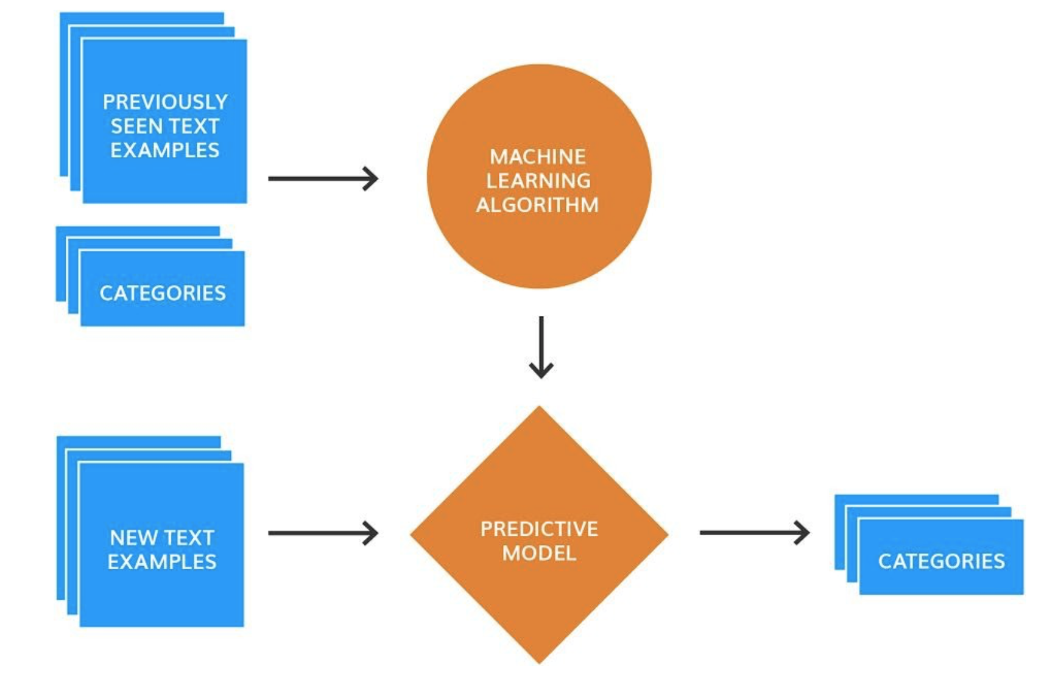
Text Classification
Supervised Machine Learning
Input:
a document d
a fixed set of classes C = {c₁, c₂,…, c_{J}}
A training set of m hand-labeled documents (d₁,c₁),....,(d_{m},c_{m})
Output:
a learned classifier γ:d → c
Notes:
More demand towards discriminative models in NLP, Speech, IR (and ML generally)
Because:
They give high accuracy performance
They make it easy to incorporate lots of linguistically important features
They allow automatic building of language independent, reusable NLP modules

Slide 24
Text Classification
Use Cases
Popular Classifiers
Discriminative models learn the boundary between classes
Generative models; model the distribution of individual classes
Naïve Bayes
Logistic regression
Support-vector machines
Assigning subject categories, topics, or genres
Spam detection
Authorship identification
Age/gender identification
Language Identification
Sentiment analysis
Models
k-Nearest Neighbors
Neural Networks
Notes:
More demand towards discriminative models in NLP, Speech, IR (and ML generally)
Because:
They give high accuracy performance
They make it easy to incorporate lots of linguistically important features
They allow automatic building of language independent, reusable NLP modules

Slide 25
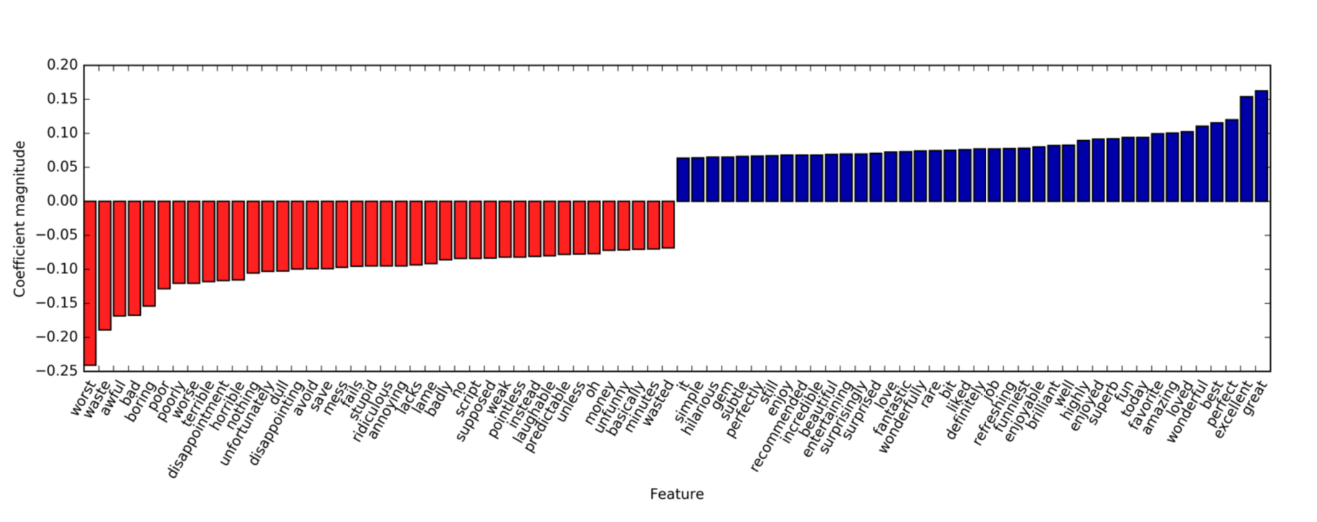
Logistic Regression classifying IMDb Movie Reviews –uni-gram
https://github.com/amueller/introduction_to_ml_with_python/blob/master/07-working-with-text-data.ipynb
Notes:
https://github.com/amueller/introduction_to_ml_with_python/blob/master/07-working-with-text-data.ipynb

Slide 26
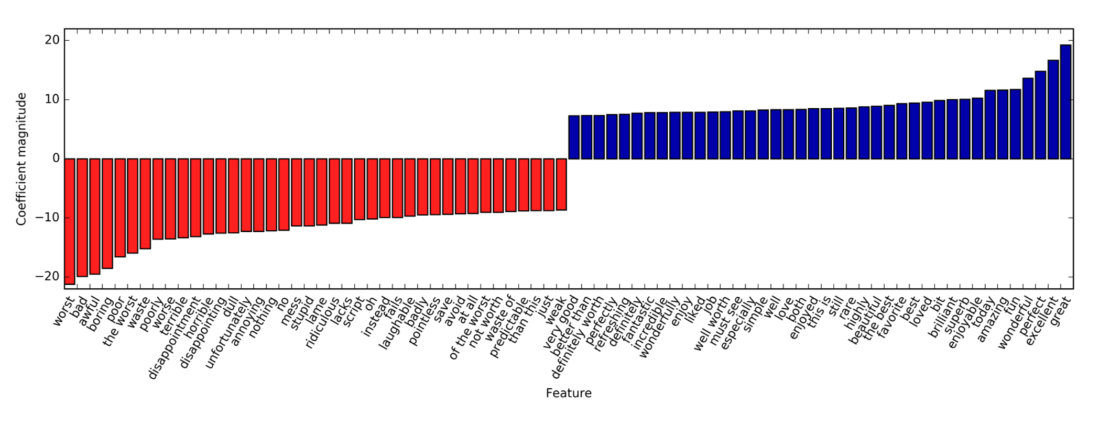
LR classifying IMDb Movie Reviews (uni-gram, bi-gram, tri-gram)
https://github.com/amueller/introduction_to_ml_with_python/blob/master/07-working-with-text-data.ipynb

Slide 27
Topic Modeling
It is an unsupervised machine learning technique for abstracting topics from a set of documents. (hidden in the aggregate statistics of the data- “latent”)
Topics can also be referred to: concepts, themes, genre
Main assumption:
Each topic is a distribution of words
Each document is a distribution of topics
Example:
words :kale, banana -→ theme : fruits
words: Puppy, cute, frog -→ theme: animal
Notes:
https://www.kdnuggets.com/2018/08/topic-modeling-lsa-plsa-lda-lda2vec.html

Slide 28
Latent Semantic Analysis (LSA)
(SVD) is used to factorize the term-document matrix into matrices that represent the term-topics, the topic importance, and the topic-documents.
Latent Semantic Analysis (LSA) is a vector-based approach first suggested as a topic modelling technique by Deerwester et al in 1990

Slide 29
Latent Dirichlet Allocation (LDA):
First introduced by David Blei, Andrew Ng, and Michael Jordan in 2003
LDA uses Dirichlet priors for the document-topic and word-topic distributions.
Learns distribution parameters by observing words co-occurrence

Slide 30
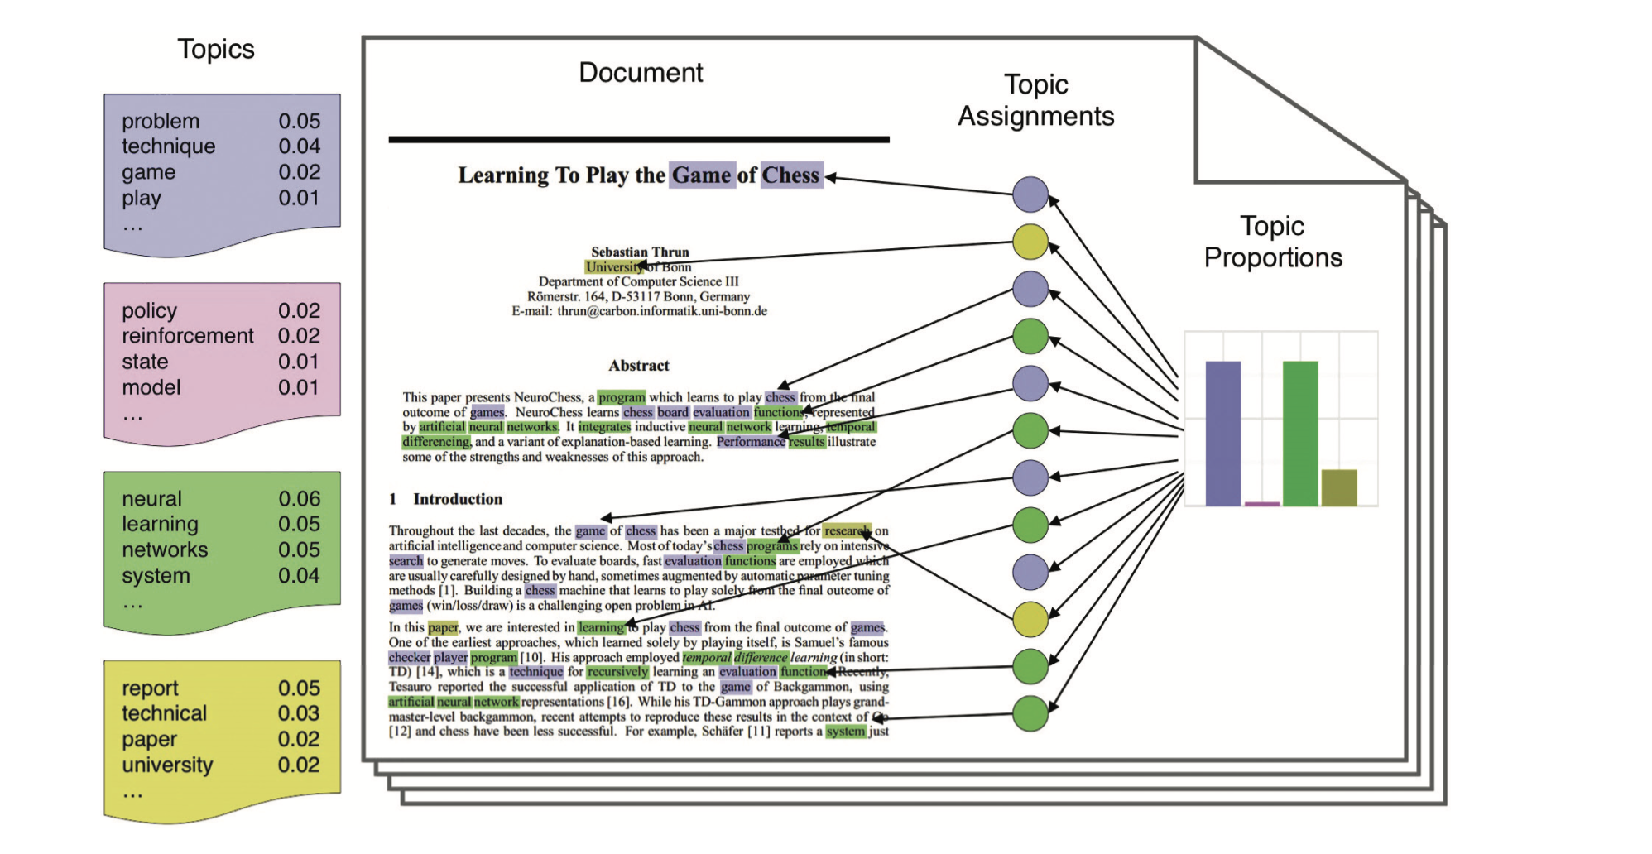
Each topic is represented in terms of the words it has the highest probability of generating
Topics:
Problem
Policy
Neural
Report
Data Science and Big Data Analytics, EMC Education Services, Wiley, 2015
Notes:
Figure 9-4 illustrates the intuitions behind LDA. The left side of the figure shows four topics built from a corpus, where each topic contains a list of the most important words from the vocabulary. The four example topics are related to problem, policy, neural, and report. For each document, a distribution over the topics is chosen, as shown in the histogram on the right. Next, a topic assignment is picked for each word in the document, and the word from the corresponding topic (colored discs) is chosen. In reality, only the documents (as shown in the middle of the figure) are available. The goal of LDA is to infer the underlying topics, topic proportions, and topic assignments for every document.
The reader can refer to the original paper [Blei, A. Ng & Jordan]] for the mathematical detail of LDA. Basically, LDA can be viewed as a case of hierarchical Bayesian estimation with a posterior distribution to group data such as documents with similar topics.

Slide 31
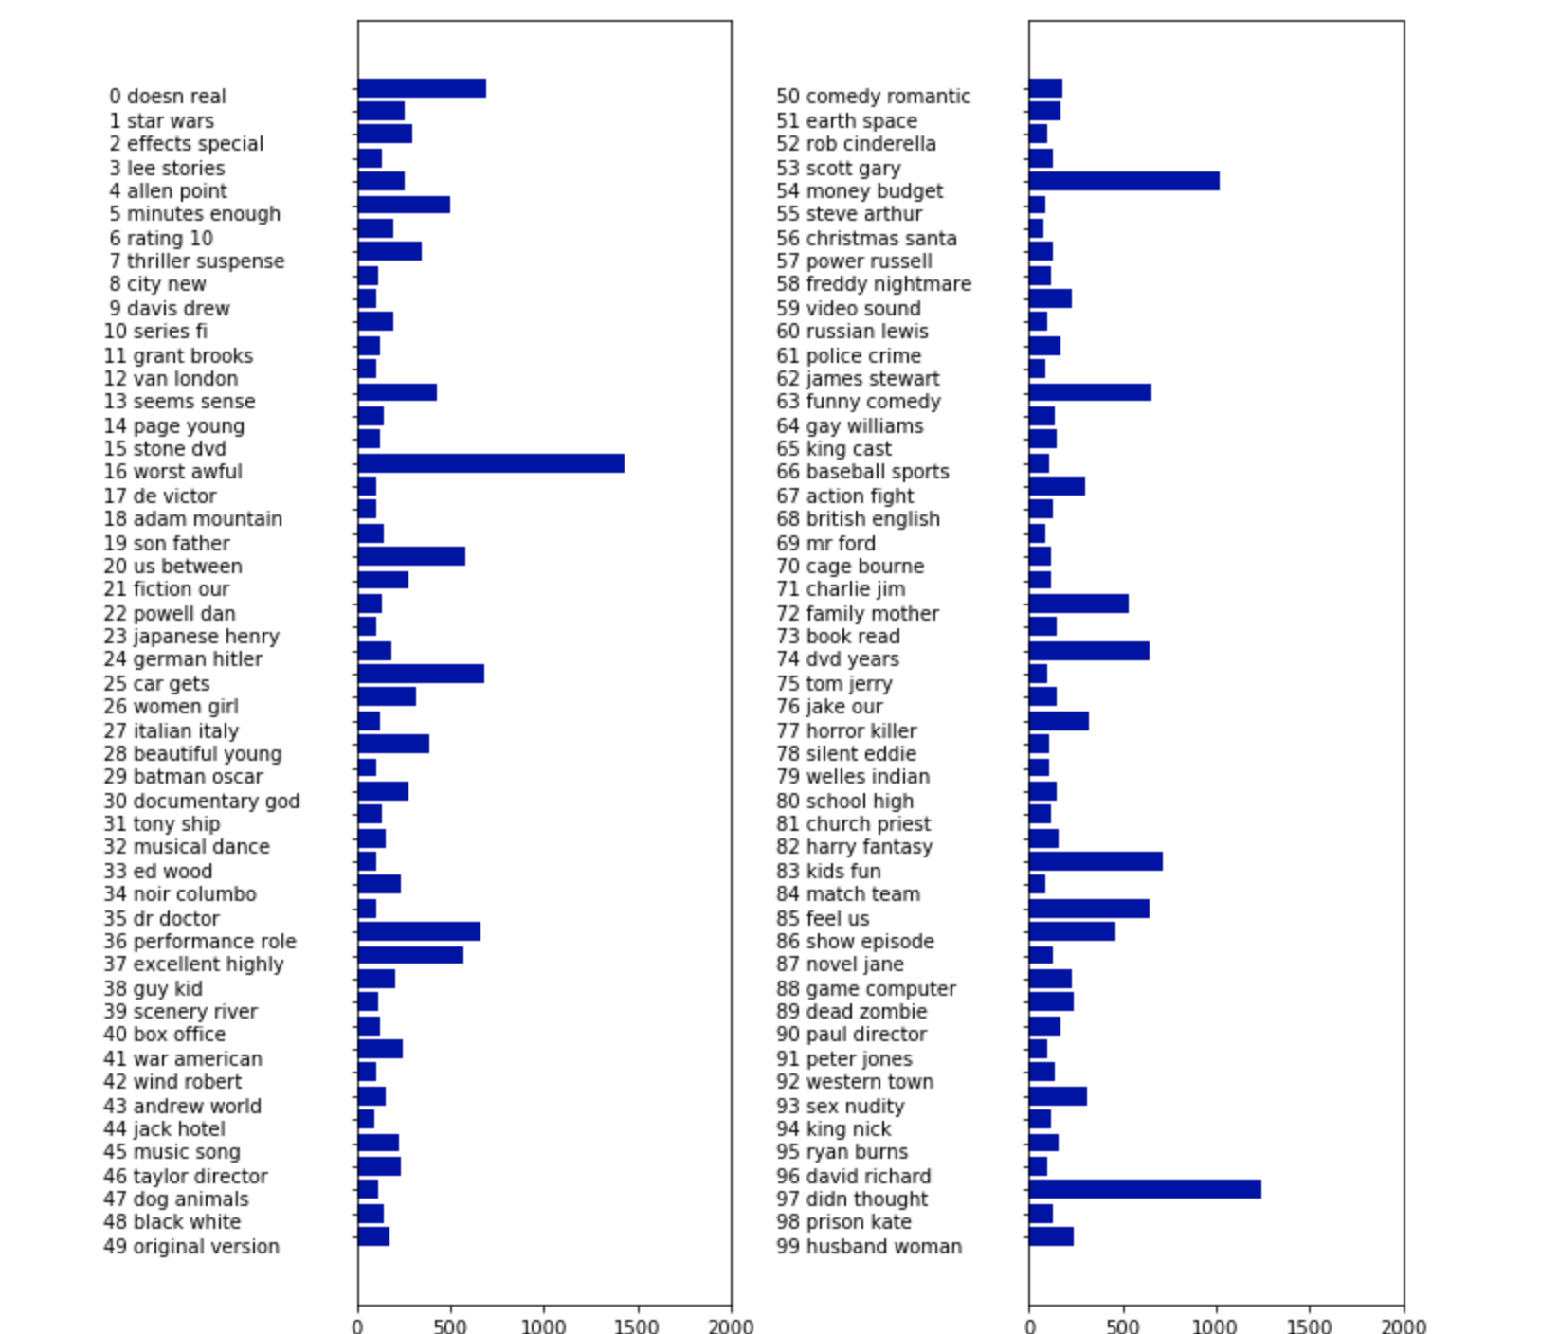
LDA on IMDb Movie Reviews
Weights for learned topics
https://github.com/amueller/introduction_to_ml_with_python/blob/master/07-working-with-text-data.ipynb
Notes:
https://github.com/amueller/introduction_to_ml_with_python/blob/master/07-working-with-text-data.ipynb

Slide 32
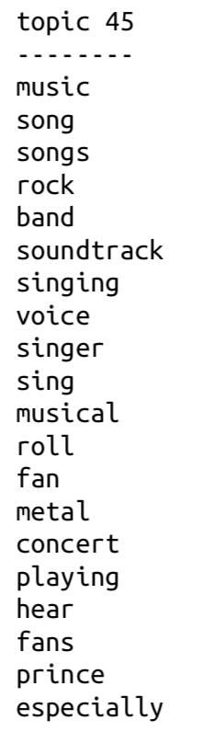
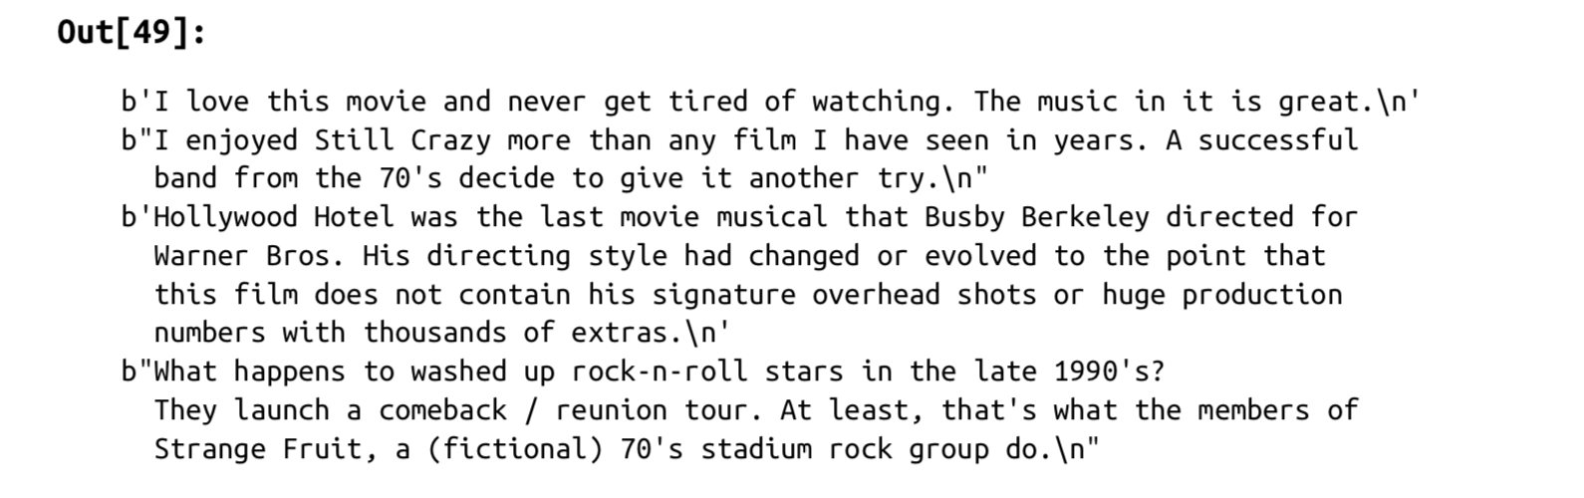
LDA on IMDb Movie Reviews
Genre specific Topic
https://github.com/amueller/introduction_to_ml_with_python/blob/master/07-working-with-text-data.ipynb

Slide 33
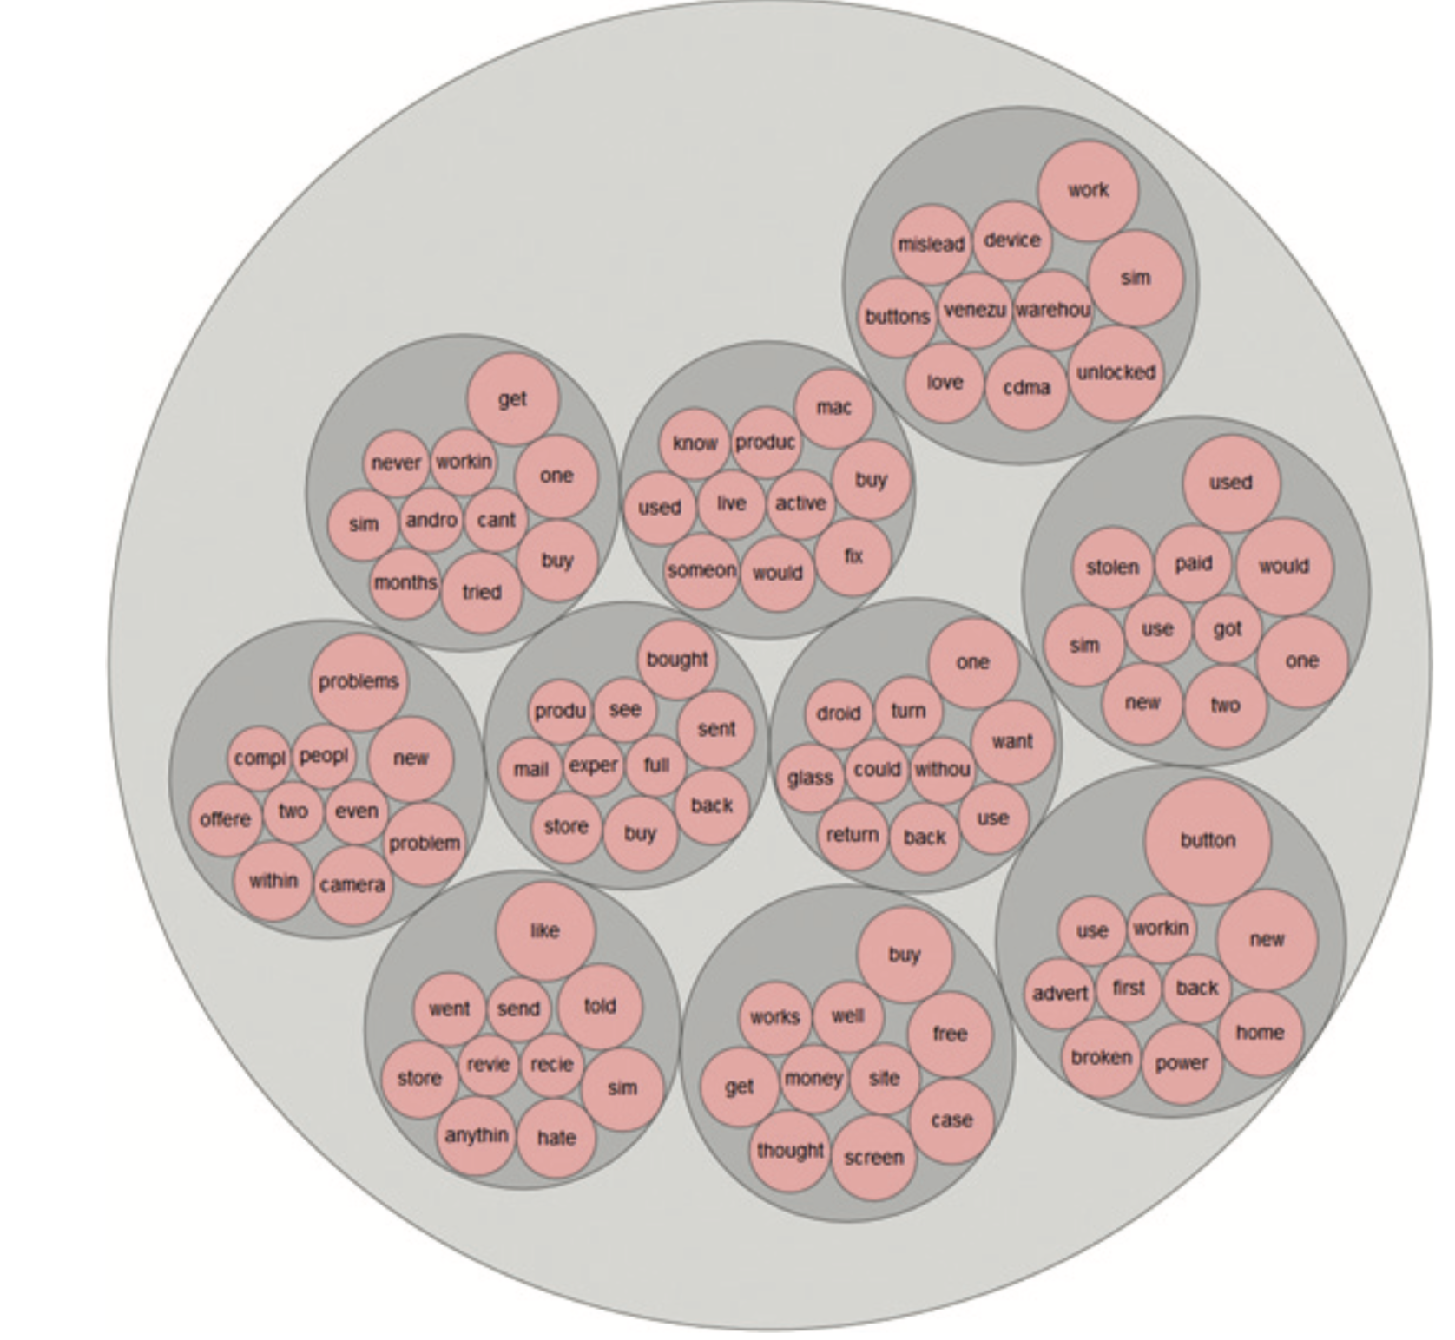
10 topics for 1star review on a phone brand
Notes:
Data Science and Big Data Analytics, EMC Education Services, Wiley, 2015

Slide 34
Python Libraries: Text Analytics & NLP
Scikit-learn: Tools for text processing and a large library for machine learning.
NLTK : Most comprehensive toolkit for NLP functions with user interface TextBlob for sentiment analysis
SpaCy library built for performance
Gensim provides good implementations for topic modeling and document similarity.
TensorFlow: ML framework for high performance computation
Hugging Face: For pre-trained NLP models, data sets & evaluation metrics
Notes:
Scikit-learn and TensorFlow are both popular machine learning frameworks in Python, but they are designed for slightly different purposes and have unique technical features.
Scikit-learn is a high-level machine learning framework for data analysis and statistical modeling. It is particularly useful for processing small to medium-sized data and for supervised learning, as well as unsupervised learning and feature selection. Scikit-learn provides a wide range of machine learning algorithms, including regression, classification, clustering, and dimensionality reduction, which can be easily used and combined to construct complex data models.
TensorFlow, on the other hand, is a low-level machine learning framework for creating machine learning models and high-performance computation. It is particularly useful for building large-scale and complex models, such as neural networks, which require a large amount of computations. TensorFlow provides a wide range of tools for creating and training machine learning models, including neural networks, optimization algorithms, and loss functions, and supports execution on GPUs and clusters to accelerate computations.
In summary, Scikit-learn is a simple and intuitive framework for data processing and statistical modeling, while TensorFlow is a powerful framework for creating large-scale and complex machine learning models. Both frameworks are very useful for data science and machine learning and can be used together to construct complete and powerful machine learning solutions.
Huggingface : unified API across more than 50 Transformer architectures. This library catalyzed
the explosion of research into transformers and quickly trickled down to NLP practitioners,
making it easy to integrate these models into many real-life applications
today. https://github.com/huggingface/transformers
It provides astandardized interface to a wide range of transformer models as well as code and
tools to adapt these models to new use cases. The library currently supports three
major deep learning frameworks (PyTorch, TensorFlow, and JAX) and allows you to
easily switch between them. In addition, it provides task-specific heads so you can
easily fine-tune transformers on downstream tasks such as text classification, named
entity recognition, and question answering. This reduces the time it takes a practitioner
to train and test a handful of models from a week to a single afternoon

Slide 35
Enhancing Bag of word (BOW)
BOW does not consider the ordering of words in a document
The cat chased the mouse.
The mouse chased the cat.
The order of words provides ‘semantic’ meaning.
Applications on language generation and sentiment analysis require more of capturing the meaning (represent ‘ text as a set of sequence’)
Notes:
BOW still works well for many applications like classification and topic modelling
Applications on language generation and sentiment analysis require more of capturing the meaning

Slide 36
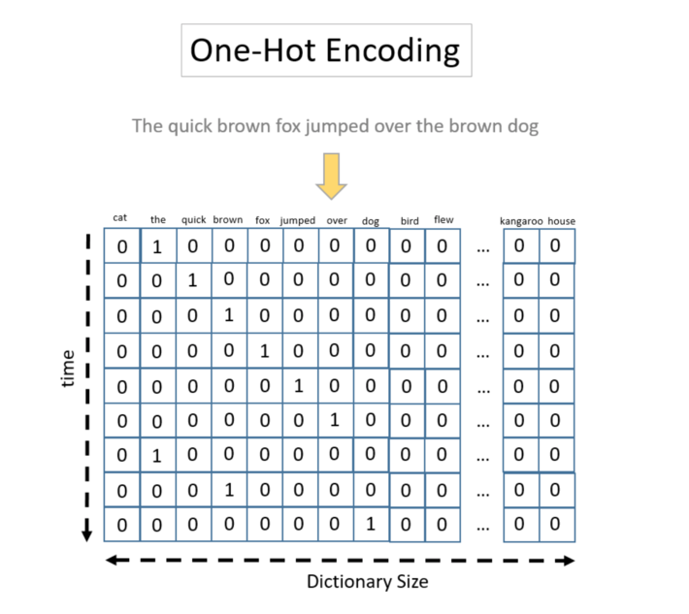
Word encoding
The hot one encoding of a word is fed into the Sequence model
(very long sequence of 0 & 1 )
Vocabulary size can be 500 000
(high-dimensional, sparse representation)
This representation does not encode any similarities
Word-embeddings:
represent words in a low-dimensional , dense representation
Words with similar meaning have similar representation
are building blocks of Neural & Deep Learning models

Slide 37
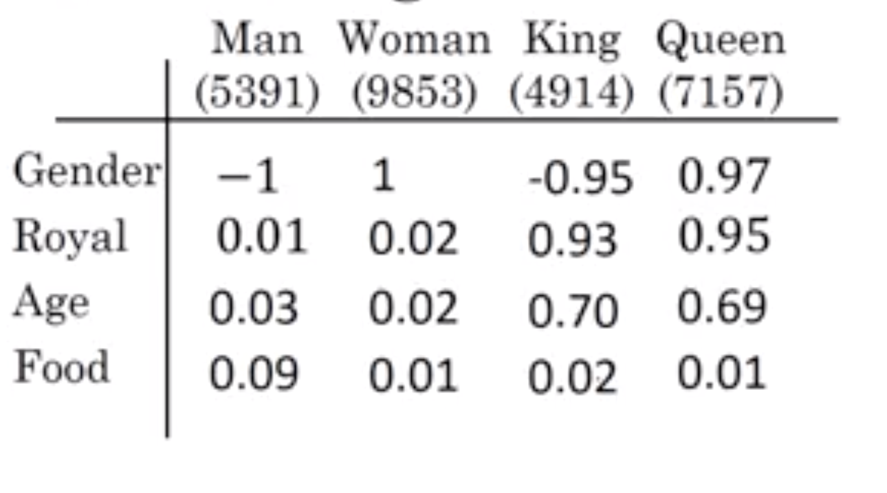
Word Embedding (capturing relational meaning)
similarity function for inferring analogy reasoning is the “cosine similarity”,
Most popular techniques:
Word2vec (developed by google)
GloVe (developed by Stanford)
Notes:
For example, the word “woman” was word number 5678 in the dictionary, and the one-hot representation was a vector of zeros with a 1 in the 5678th position.
https://www.kdnuggets.com/2016/05/amazing-power-word-vectors.html

Slide 38
Word2vec Models
The cat ate the hat
CBOW
Input (context words)
Output (centre/target word) ate
Skip-gram
Input (centre/target word) ate
Output (context words)

Slide 39
Dense embeddings you can download!
You can find pre-trained models on huge corpora
Examples:
http://nlp.stanford.edu/projects/glove/
http://code.google.com/archive/p/word2vec/
Another approach by Facebook “Fasttext” (Bojanowski 2016) using skip-grams(faster to train) but with n-grams not whole words http://arxiv.org/abs/1607.04606
You can load pretrained embeddings to initialize your NN weights. Useful in practice but know they encode cultural stereotypes (Bias)

Slide 40
Deep Learning for NLP
Deep Learning models have revolutionized the fields text analytics & NLP
Encode grammatical structure of the language from text examples ( less domain knowledge)
Compute rich language features from data with limited human intervention
Can model sequence and long term dependencies in text
Notes:
https://towardsdatascience.com/understanding-rnn-and-lstm-f7cdf6dfc14e
https://www.kdnuggets.com/2019/02/deep-learning-nlp-rnn-cnn.html

Slide 41
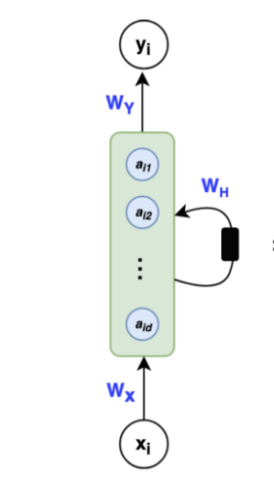
Sequence models for text
RNN is a sequential model that can perceive the text as a sequence of characters & words.
Unlike other NN models:
Take sequential input of any length
Share parameters over time
Vanishing/exploding gradients are a problem in RNN
Variations of RNNs , LSTM and GRU , use gates to control information flow
( add notion of memory)

Slide 42
RNN models in NLP Applications
Machine Translation
Sentiment Classification
Interesting Reads:
Understanding LSTMs
Recurrent Neural Networks cheat sheet
Notes:
DL net captures semantic and syntactic relation of one language and can translate it to another language)
One area where RNNs played an important role was in the development of machine
translation systems, where the objective is to map a sequence of words in one language
to another. This kind of task is usually tackled with an encoder-decoder or
sequence-to-sequence architecture,5 which is well suited for situations where the input
and output are both sequences of arbitrary length. The job of the encoder is to
encode the information from the input sequence into a numerical representation that
is often called the last hidden state. This state is then passed to the decoder, which
generates the output sequence.

Slide 43
The big break through for NLP: Transformers
Are Deep Neural Network models that excel in capturing relationships and attention in text*
Unlike RNNs Transformers do not take input as a sequence and use positional encoding to retain poitional information
Operations in Transformers can be easily pararellized (GPUs )
Transformer models are the base of many foundation models that are trained on huge corpra for months. Those models can be fine tuned to create custom AI model in few hours
Based on work A. Vaswani et al., “Attention Is All You Need”, (2017) https://arxiv.org/pdf/1706.03762.pdf
outperformed recurrent neural networks (RNNs) on machine translation tasks, both in terms of translation quality and training cost.

Slide 44
The Transformer Architecture
Encoder
Converts an input sequence of tokens into a sequence of embedding vectors, often called the hidden state or context (machine readable representation)
Decoder
Uses the encoder’s hidden state to iteratively generate an output sequence of tokens, one token at a time (generate human readable sequence)

Slide 45
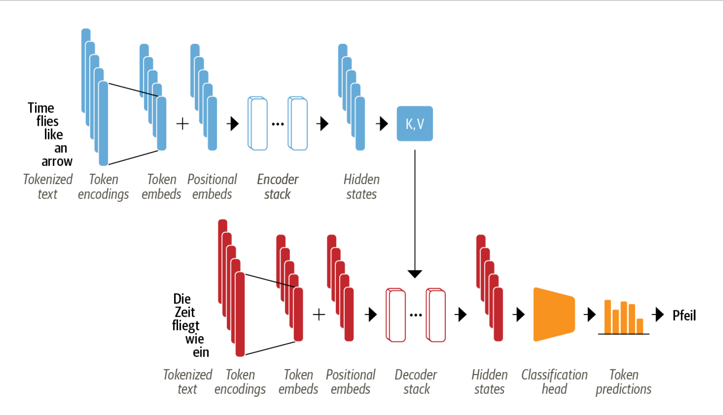
The Transformer Architecture (original architecture)
Notes:
The encoder is composed of a stack of encoder layers or “blocks,” which is analogous to stacking convolutional layers in computer vision. The same is true of the
decoder, which has its own stack of decoder layers.
• The encoder’s output is fed to each decoder layer, and the decoder then generates a prediction for the most probable next token in the sequence. The output of this
step is then fed back into the decoder to generate the next token, and so on until a special end-of-sequence (EOS) token is reached. In the example from
Figure 3-1, imagine the decoder has already predicted “Die” and “Zeit”. Now it gets these two as an input as well as all the encoder’s outputs to predict the next
token, “fliegt”. In the next step the decoder gets “fliegt” as an additional input. We
repeat the process until the decoder predicts the EOS token or we reached a maximum
length.

Slide 46

The Transformer Architecture
1. encoder’s output is fed to each decoder layer
3. Output is fed back into the decoder to generate the next token.
Repeat until
a (EOS) token is reached.
2. decoder then generates
a prediction for the most probable next token in the sequence.
Notes:
The encoder is composed of a stack of encoder layers or “blocks,” which is analogous
to stacking convolutional layers in computer vision. The same is true of the
decoder, which has its own stack of decoder layers.
• The encoder’s output is fed to each decoder layer, and the decoder then generates
a prediction for the most probable next token in the sequence. The output of this
step is then fed back into the decoder to generate the next token, and so on until
a special end-of-sequence (EOS) token is reached. In the example from
Figure 3-1, imagine the decoder has already predicted “Die” and “Zeit”. Now it
gets these two as an input as well as all the encoder’s outputs to predict the next
token, “fliegt”. In the next step the decoder gets “fliegt” as an additional input. We
repeat the process until the decoder predicts the EOS token or we reached a maximum
length.

Slide 47
The Transformer Architecture- Decoder side
Encoder’s output is fed to each decoder layer
<SOS> Die
Die Zeit
Die Zeit fliegt
Die Zeit fliegt wie
Die Zeit fliegt wie ein
Die Zeit fliegt wie ein Pfeil
Die Zeit fliegt wie ein Pfeil <EOS>
Notes:
The encoder is composed of a stack of encoder layers or “blocks,” which is analogous
to stacking convolutional layers in computer vision. The same is true of the
decoder, which has its own stack of decoder layers.
• The encoder’s output is fed to each decoder layer, and the decoder then generates
a prediction for the most probable next token in the sequence. The output of this
step is then fed back into the decoder to generate the next token, and so on until
a special end-of-sequence (EOS) token is reached. In the example from
Figure 3-1, imagine the decoder has already predicted “Die” and “Zeit”. Now it
gets these two as an input as well as all the encoder’s outputs to predict the next
token, “fliegt”. In the next step the decoder gets “fliegt” as an additional input. We
repeat the process until the decoder predicts the EOS token or we reached a maximum
length.

Slide 48
The Transformer Categories
Originally designed for sequence-to-sequence tasks like machine translation, but both the encoder and decoder blocks were soon adapted as standalone models
Encoder-only
convert an input sequence of text into a rich numerical representation
Used for text classification or named entity recognition.
BERT and its variants, like RoBERTa and DistilBERT
Decoder-only
The family of GPT models belong to this class.
models will autocomplete the sequence by iteratively predicting the most probable next word
Further Encoders in addition to Transformers: BART and T5 models
suitable for machine translation and summarization tasks

Slide 49
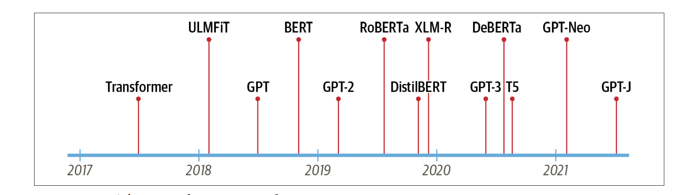
NLP & transformer models “ All you need is Attention”
Pertained models & transfer learning for NLP
Today’s most well-known transformers (2018):
Generative Pretrained Transformer (GPT)
Bidirectional Encoder Representations from Transformers (BERT)
A Zoo of transformers emerges:
GPT pretrained on BookCorpus (7000 unpublished books)
BERT pertained on BookCorpus and English Wikipedia
Notes:
GPT and BERT set a new state of the art across a variety of NLP benchmarks and
ushered in the age of transformers.
A. Radford et al., “Improving Language Understanding by Generative Pre-Training”, (2018).
J. Devlin et al., “BERT: Pre-Training of Deep Bidirectional Transformers for Language Understanding”,
(2018).
GPT
Uses only the decoder part of the Transformer architecture, and the same language
modeling approach as ULMFiT. GPT was pretrained on the BookCorpus,11
which consists of 7,000 unpublished books from a variety of genres including
Adventure, Fantasy, and Romance.
BERT
Uses the encoder part of the Transformer architecture, and a special form of language
modeling called masked language modeling. The objective of masked language
modeling is to predict randomly masked words in a text. For example,
given a sentence like “I looked at my [MASK] and saw that [MASK] was late.” the
model needs to predict the most likely candidates for the masked words that are
denoted by [MASK]. BERT was pretrained on the BookCorpus and English
Wikipedia.

Slide 50
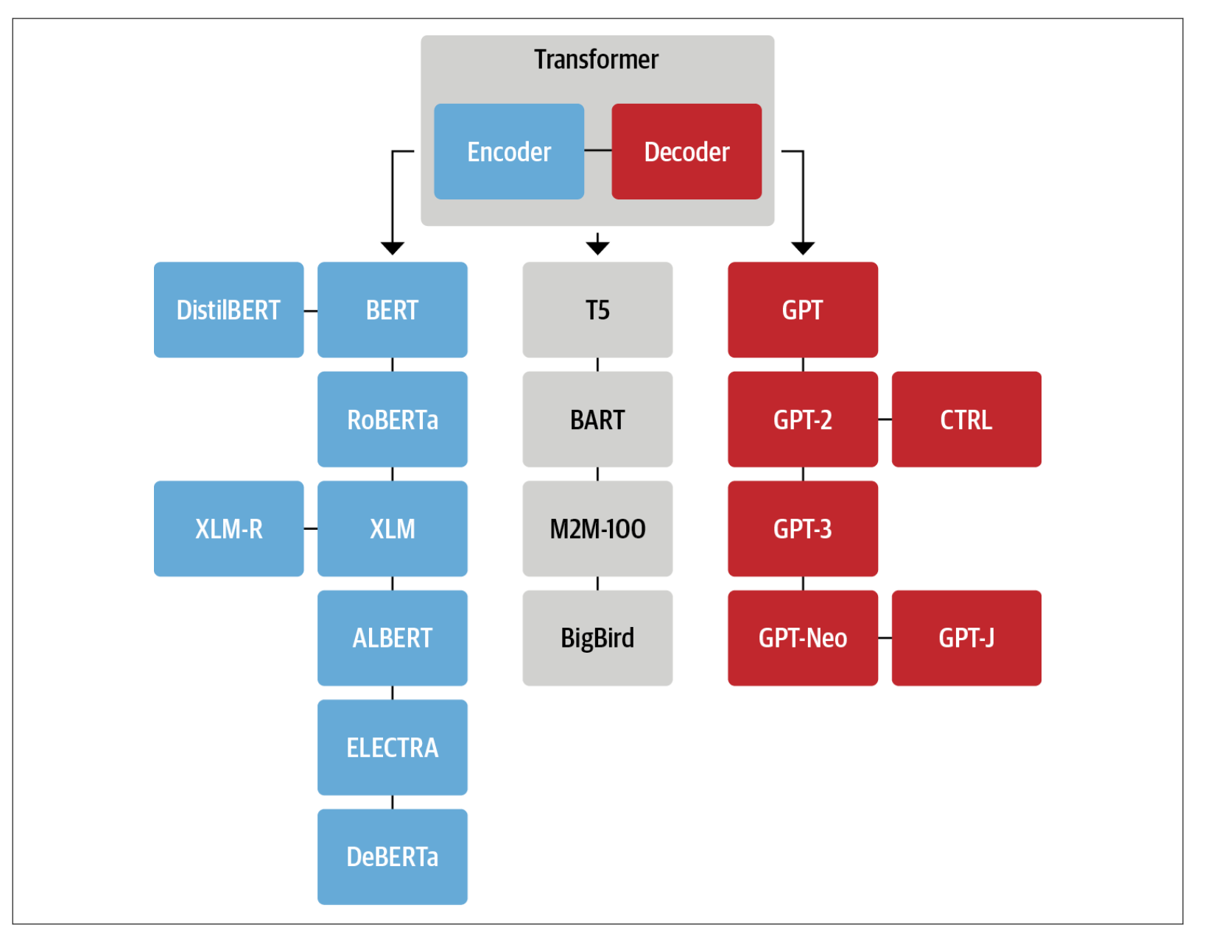
Key Transformer models
researchers built models on various datasets of different size and nature, used new pretraining objectives, and tweaked the architecture to further improve performance
Notes:
(p.80-84) [1] Natural Language Processing with Transformers, Revised Edition, 2022, by Lewis Tunstall, Leandro von Werra, and Thomas Revised copy available on discovery ( EbookLinks to an external site. )

Slide 51
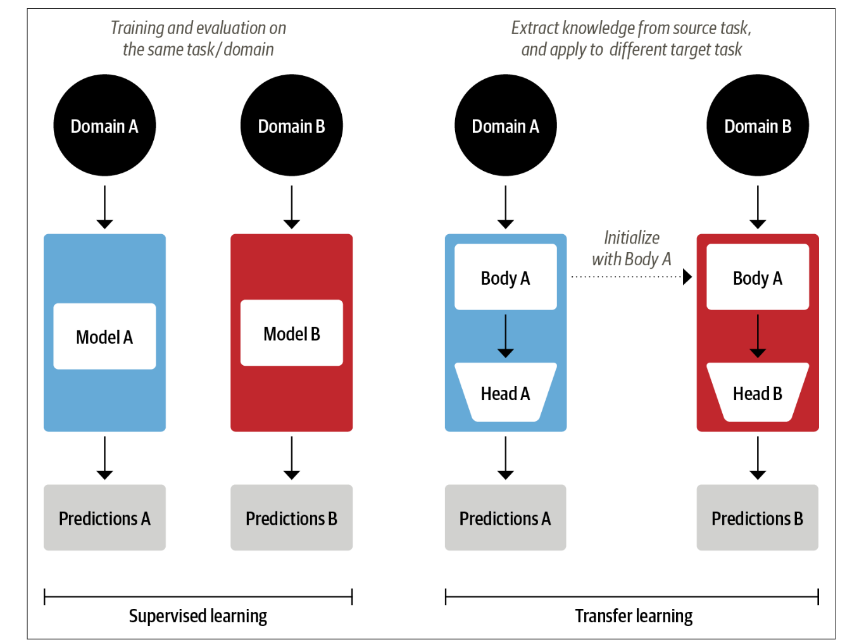
Transfer Learning in NLP
NLP applications typically required large amounts of labeled data to achieve high performance.
Transfer Learning produces high-quality models that can be trained much more efficiently on a variety of downstream tasks, and with much less labeled data.
GPT and BERT set a new state of the art by combined self-attention with transfer learning for NLP

Slide 52
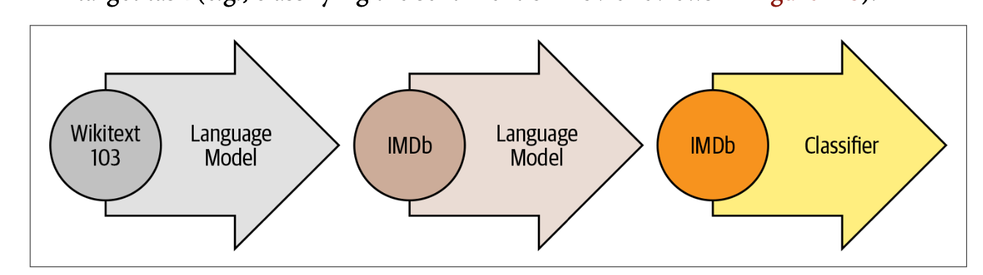
Transfer Learning in NLP
ULMFiT model
predict the next word based on the previous words using large corpus; Wikipedia (language modeling)
adapt it to the in-domain corpus (IMDb corpus of movie reviews-language modeling on target corpus)
Add classification layer for the target task (e.g., classifying the sentiment of movie reviews )
Notes:
Pretraining
The initial training objective is quite simple: predict the next word based on the previous words. This task is referred to as language modeling. The elegance of this approach lies in the fact that no labeled data is required, and one can make use of abundantly available text from sources such as Wikipedia.10
Domain adaptation
Once the language model is pretrained on a large-scale corpus, the next step is to adapt it to the in-domain corpus (e.g., from Wikipedia to the IMDb corpus of movie reviews, as in Figure 1-8). This stage still uses language modeling, but now the model has to predict the next word in the target corpus.
Fine-tuning
In this step, the language model is fine-tuned with a classification layer for the target task (e.g., classifying the sentiment of movie reviews in Figure 1-8).

Slide 53
Transfer Learning in NLP
GPT:
uses only decoder part & language modeling
model was pretrained by predicting the next word based on the previous ones.
pretrained on the BookCorpus,11 which consists of 7,000 unpublished books
BERT:
Uses the encoder part of the Transformer architecture
pretrained on the BookCorpus and English Wikipedia.
Trained to predict randomly masked words in a text.
“I looked at my [MASK] and saw that [MASK] was late.”
Also trained on next sentence prediction (NSP).
Notes:
Pretraining
The initial training objective is quite simple: predict the next word based on the previous words. This task is referred to as language modeling. The elegance of this approach lies in the fact that no labeled data is required, and one can make use of abundantly available text from sources such as Wikipedia.10
Domain adaptation
Once the language model is pretrained on a large-scale corpus, the next step is to adapt it to the in-domain corpus (e.g., from Wikipedia to the IMDb corpus of movie reviews, as in Figure 1-8). This stage still uses language modeling, but now the model has to predict the next word in the target corpus.
Fine-tuning
In this step, the language model is fine-tuned with a classification layer for the target task (e.g., classifying the sentiment of movie reviews in Figure 1-8).

Slide 54
Hugging Face Transformers
It provides a standardized interface to a wide range of transformer models as well as code and tools to adapt these models to new use cases.
Supports three major deep learning frameworks (PyTorch, TensorFlow, and JAX)
Provides task-specific heads so you can easily fine-tune transformers on downstream tasks such as text classification, named entity recognition, and question answering.
Reduces the time it takes a practitioner to train and test a handful of models
Released more than 200,000++ models https://huggingface.co/docs/transformers/index
Tutorial how to load models, fine tune them and use data https://huggingface.co/course/chapter0/1?fw=pt
[1] Natural Language Processing with Transformers, Revised Edition, 2022, by Lewis Tunstall, Leandro von Werra, and Thomas Revised copy available on discovery ( EbookLinks to an external site. )
Notes:
different research labs releasing their models in incompatible frame‐ works (PyTorch or TensorFlow), it wasn’t always easy for NLP practitioners to port these models to their own applications.

Slide 55
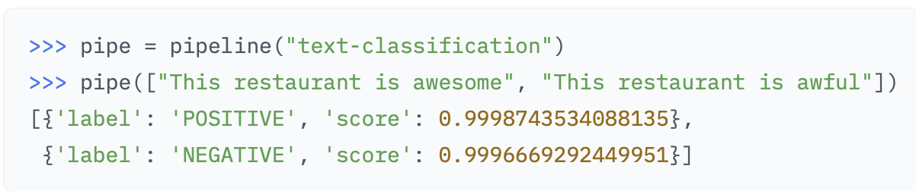
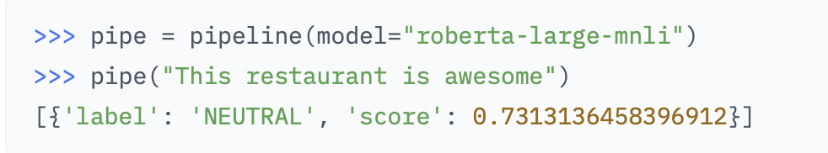
Pipelines in Huggingface –code
https://huggingface.co/docs/transformers/main_classes/pipelines
easy way to use models for inference
Pipelines are objects that abstract most of the complex code
Offers a simple API for tasks, like Named Entity Recognition, Masked Language Modeling, Sentiment Analysis, Feature Extraction and Question Answering.
Notes:
we instantiate a pipeline by calling the pipeline() function and providing the name of the task we are interested in
By default, the text-classification pipeline uses a model that’s designed for sentiment analy‐ sis, but it also supports multiclass and multilabel classification.
Each pipeline takes a string of text (or a list of strings) as input and returns a list of predictions. Each prediction is a Python dictionary, so we can use Pandas to display them nicely as a DataFrame:
pd.DataFrame(pipe)

Slide 56
Transformer NLP Applications (Hands-on)
Test Classification: Identify if a customer feedback is positive or negative (sentiment analysis)
Named Entity Recognition: identify named entities like products, places, and people (named entity recognition -NER)
Question Answering: provide the model with a passage of text called “context”, along with a question whose answer we’d like to extract. The model then returns the span of text corresponding to the answer (example here is extractive question answering because the answer is extracted directly from the text)
https://colab.research.google.com/github/nlp-with-transformers/notebooks/blob/main/01_introduction.ipynb#scrollTo=5ygcsdXvVdcc

Slide 57
Transformer NLP Applications (Hands-on)-cont.
Summarization: take a long text as input and generate a short version with all the relevant facts. More complicated task that requires the model to generate coherent text.
Translation: generated text in a different language
translator = pipeline("translation_en_to_de", model="Helsinki-NLP/opus-mt-en-de")
# override the default model in the pipeline to pick the best one for your application
outputs = translator(text, clean_up_tokenization_spaces=True, min_length=100)
print(outputs[0]['translation_text'])
Text Generation: faster replies to customer feedback by having access to an autocomplete function.
https://colab.research.google.com/github/nlp-with-transformers/notebooks/blob/main/01_introduction.ipynb#scrollTo=5ygcsdXvVdcc
Notes:
you can override the default model in the pipeline to pick the best one for your application—and you can find models for thousands of language pairs on the Hugging Face Hub.

Slide 58
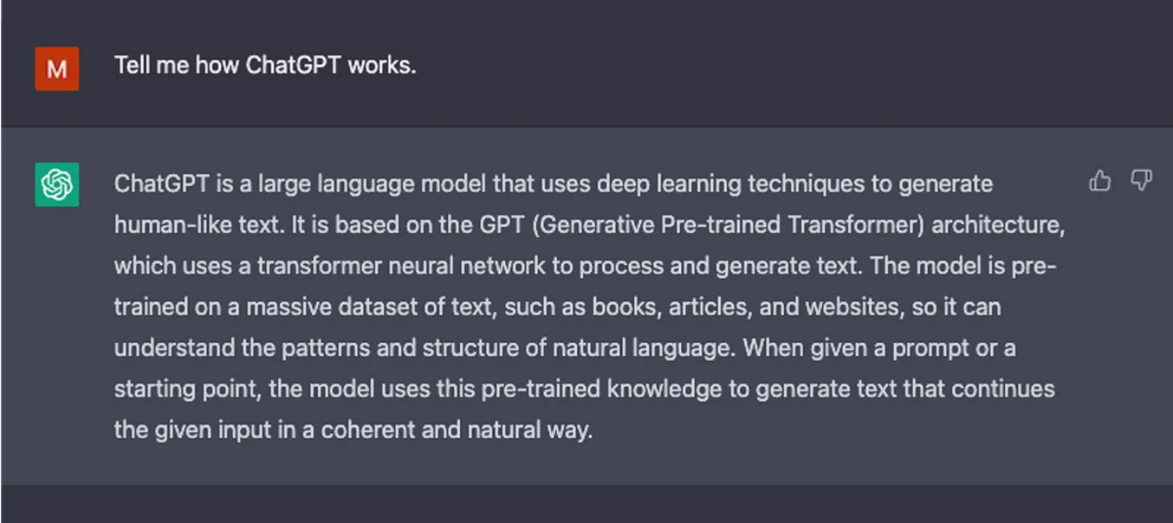
ChatGPT (How it works)
How ChatGPT Works: The Model Behind The Bot
Relies on GPT-3 trained with self-attention mechanism, and then used Reinforcement Learning to integrate human feedback in the system

Slide 59
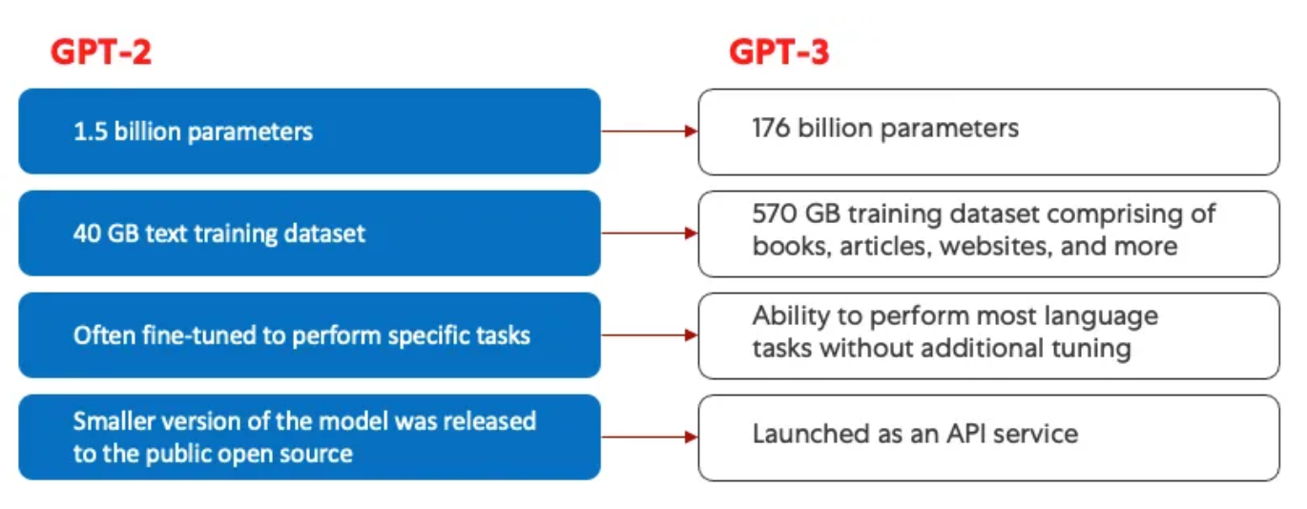
ChatGPT (How it works)-2
Some issues with GPT-3 is that it is limited in its ability to align with user intentions.
Cannot follow users exact instructions
Not easily interpretable
Can contain hallucinations
Can contain bias and toxic content
Enhancement for ChatGPT = train language models to follow instructions with human feedback
How ChatGPT Works: The Model Behind The Bot
GPT models use the transformer architecture and self-attention mechanism & ‘multi-head’ attention mechanism

Slide 60
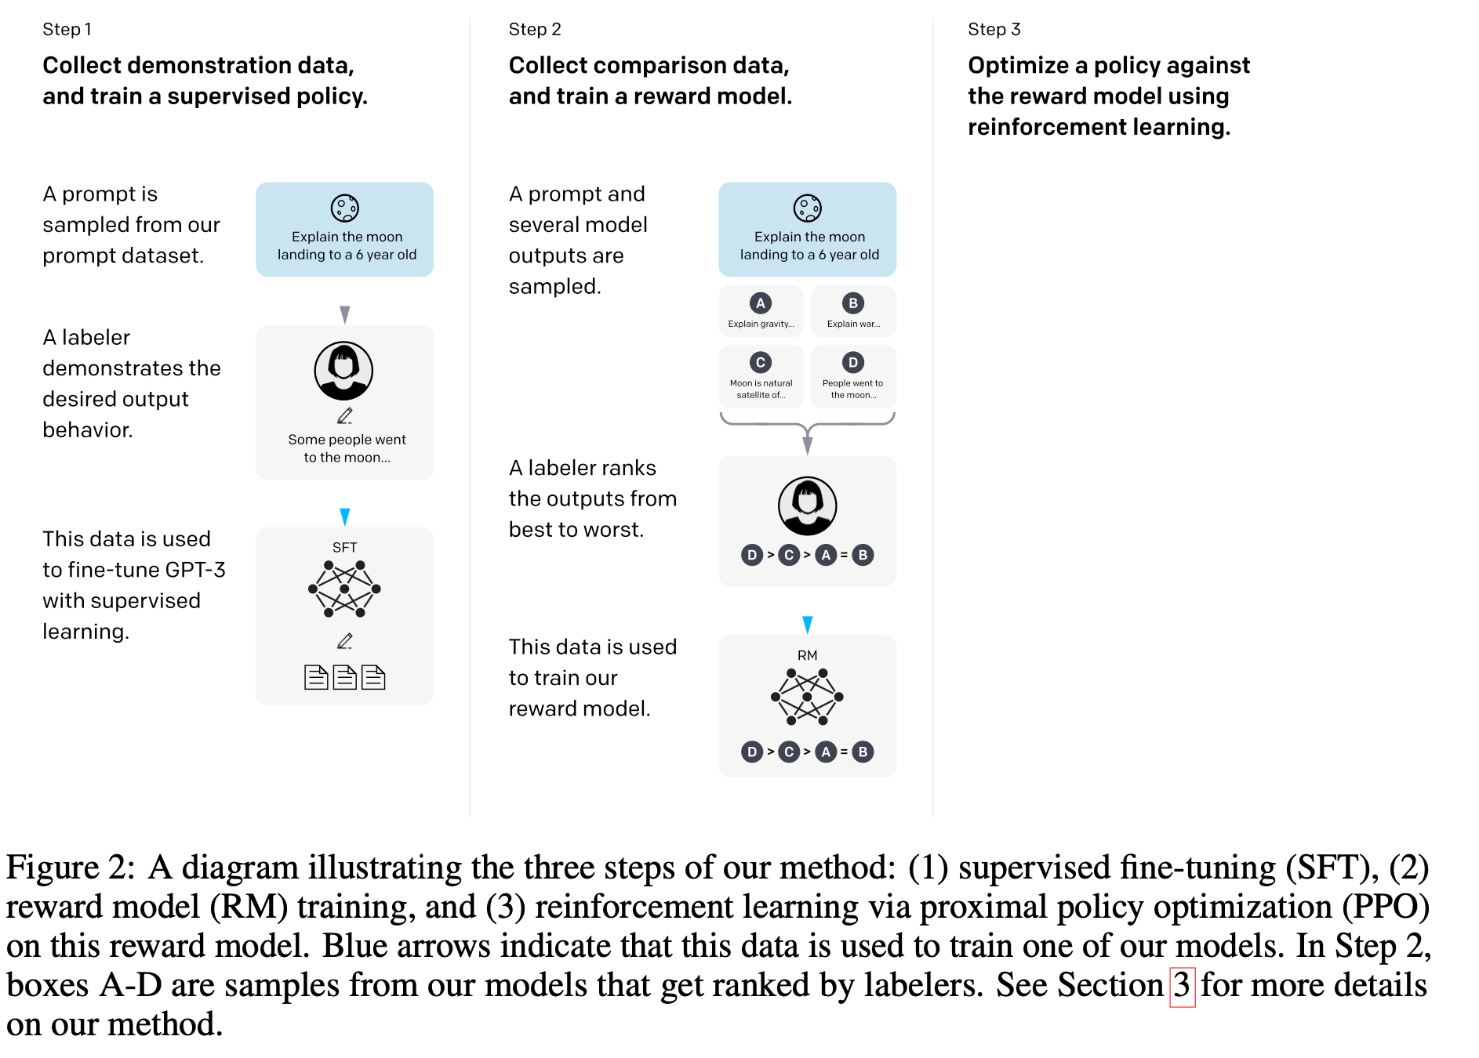
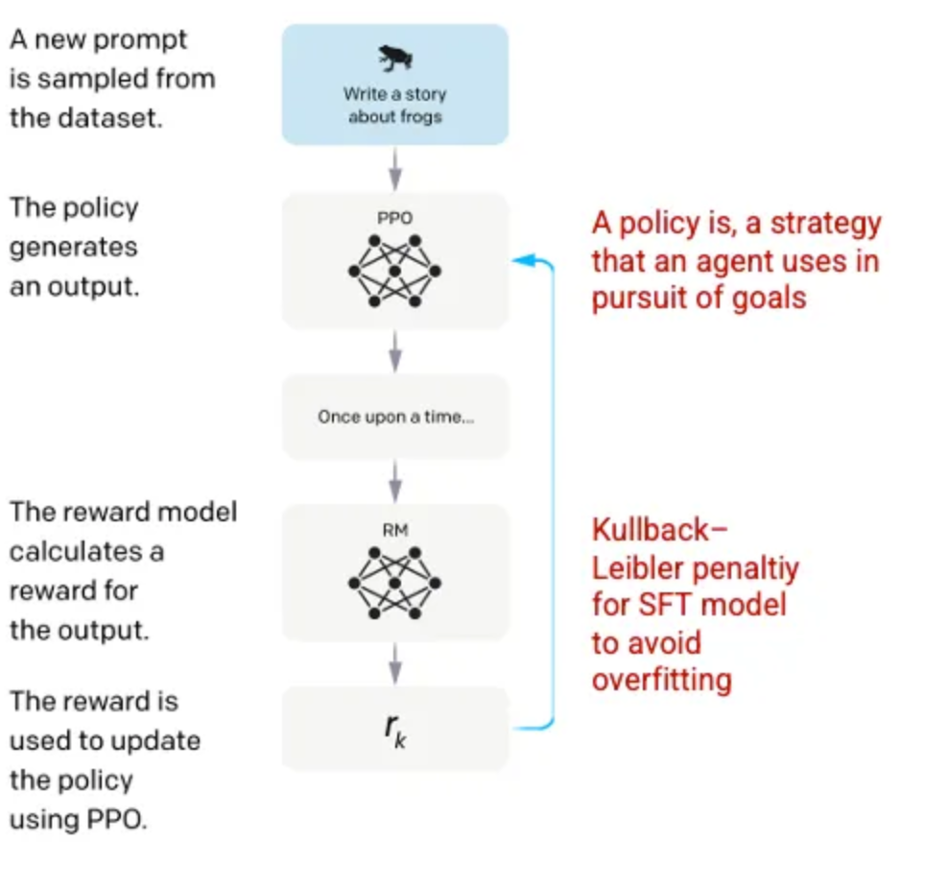
ChatGPT (How it works)-3
Training language models to follow instructions with human feedback
Open AI 2022 paper
Based on PPO (Proximal Policy Optimization)
ChatGPT is a spinoff of InstructGPT, which introduced a novel approach to incorporating human feedback into the training process to better align the model outputs with user intent.
Step 1: Supervised Fine Tuning (SFT) Model
Step 2: Reward Model
Step 3: Reinforcement Learning Model
Notes:
Step1: The labelers then wrote an appropriate response to the prompt thus creating a known output for each input. The GPT-3 model was then fine-tuned using this new, supervised dataset, to create GPT-3.5, also called the SFT model.
Step2: To train the reward model, labelers are presented with 4 to 9 SFT model outputs for a single input prompt. They are asked to rank these outputs from best to worst, creating combinations of output ranking. The reward model is required in order to leverage Reinforcement Learning in which a model learns to produce outputs to maximize its reward
Step3: the model is presented with a random prompt and returns a response. The response is generated using the ‘policy’ that the model has learned in step 2. The policy represents a strategy that the machine has learned to use to achieve its goal; in this case, maximizing its reward. The reward then feeds back into the model to evolve the policy.

Slide 61
Todays Hype
Foundation Models & Generative AI
“Foundation models are large AI models trained on enormous quantities of unlabeled data—usually through self-supervised learning. This process results in generalized models capable of a wide variety of tasks in NLP and Vision/speech”
Examples: BERT, GPT-3 , ChatGPT, Stable Diffusion, Google’s LaMDA, DALL-E, GPT-4…
Guide to Foundation modles and their adoption in enterprise
Notes:
Encoder-only models still dominate research and industry on NLU tasks such as text classification, named entity recognition, and question answering. Let’s have a brief look at the BERT model and its variants

Slide 62
Introductory resources NLP/LLM
Code:
Chapter 3 https://colab.research.google.com/github/nlp-with transformers/notebooks/blob/main/03_transformer-anatomy.ipynb
Chapter 1 https://colab.research.google.com/github/nlp-with-transformers/notebooks/blob/main/01_introduction.ipynb
Readings Chapter 1 &3:
[1] Natural Language Processing with Transformers, Revised Edition, 2022, by Lewis Tunstall, Leandro von Werra, and Thomas Revised copy available on discovery ( EbookLinks to an external site. )
Invited talk by Amazon Alexa on NLP 2022 (session recordingLinks to an external site.)

Slide 63
Key Points for future
Advancements in areas NLP , ML and text analytics will transform business services (improving customer experiences)
Technology will support conversational engagements ( smart assistants & chatbots)
Industry reports indicate that the demand for NLP experts will grow exponentially in the near future.
Will it revolutionize search engines, ..
Report by Tractica:
2025 NLP market would be around $22.3 billion
(hardware –applications –services)
AI-enabled NLP software market will rise to $5.4 billion in 2025.

Slide 64
Course Resources
Books:
Machine Learning for Text, Charu C. Aggarwal,2018
An Introduction to Natural Language Processing, Computational Linguistics, and Speech Recognition, Third Edition draft , Daniel Jurafsky & James H. Martin Also see video lectures
Python:
Applied Text Analysis with Python by Benjamin Bengfort, Rebecca Bilbro, and Tony Ojeda (O’Reilly).2018.
Short Reads for Professionals:
Kdnuggets TowardsDataScience
Video lectures (NLP &DL Stanford): Advanced
NATURAL LANGUAGE PROCESSING WITH DEEP LEARNING
Natural Language Processing with Transformers, Revised Edition, 2022, by Lewis Tunstall, Leandro von Werra, and Thomas Revised copy available on discovery (Ebook )
Notes:
Kdnuggets
Towardsdatascience
NLP Stanford book ? https://nlp.stanford.edu/IR-book/html/htmledition/dropping-common-terms-stop-words-1.html

Slide 65

Unprecedent times for NLP & AI
Article by Chris manning, professor in Stanford University
10 January 2023
“Language models write credibly, but not necessarily the truth”
Chris presents a nice history on the development of the NLP and comment on the current breakthroughs
“ in the late 1980s, people tried to teach language to computers by introducing rules, grammar, and logic into those computers. …digital texts became available, such as court proceedings and newspaper archives… the approach changed statistical NLP. Then that merged with machine learning, a form of artificial intelligence that can discover patterns on its own in a huge amount of data
…………….. In 2018, they discovered that if you take a huge amount of human language and train a giant neural network to predict words, you get a model that can do much more…..
Right now, computers learn language by reading a huge amount of text and learning to predict what people are saying or writing”
Listen to interview May 2023 https://www.youtube.com/watch?v=biN5yufyLZM
Notes:
GPT-3 is an AI model trained with language. It can write paragraphs indistinguishable from human writing. But it can also, for example, summarize a news article in three sentences, or predict the folding of a protein. It blows my mind that that works.”

Slide 66
Questions?
Thank you and welcome to the course

